Slide 1
Location. Location. Location.
An analysis of home price variability in Minneapolis communities
Andrew bartczak, terrence cummings, jon simpson

Slide 2
Table of Contents
Motivation and Summary
Data Analysis
Summary of Conclusions
Discussion & Questions
Appendix
Data Interrogation – What questions are we asking of the data?
Home Data – Cleanup & Exploration
Crime Data – Cleanup & Exploration
Education Data – Cleanup & Exploration
Post-mortem

Slide 3
Motivation and summary
There is significant variability in home values in Minneapolis which appears to be aligned to neighborhoods or communities.
Do home values between communities vary to a statistically significant degree?
If so, what are the key characteristics of a neighborhood that impact the value of homes?
Does the size of the home impact the value per square foot or just the total value?
To what degree does the rate of violent and non-violent crime drive down home values?
How much does the quality of nearby schools increase home value?
Such an analysis can assist local governments in allocation of resource in addressing crime and education. It can also help home buyers and seller identify under or over-valued properties based on their personal views on the importance of crime or education in home purchasing.
Hypothesis: Crime rate and school quality have large negative and positive correlations respectively with home values. These variables explain a significant portion of the variance in home values between Minneapolis neighborhoods.

Slide 4
Data analysis

Slide 5
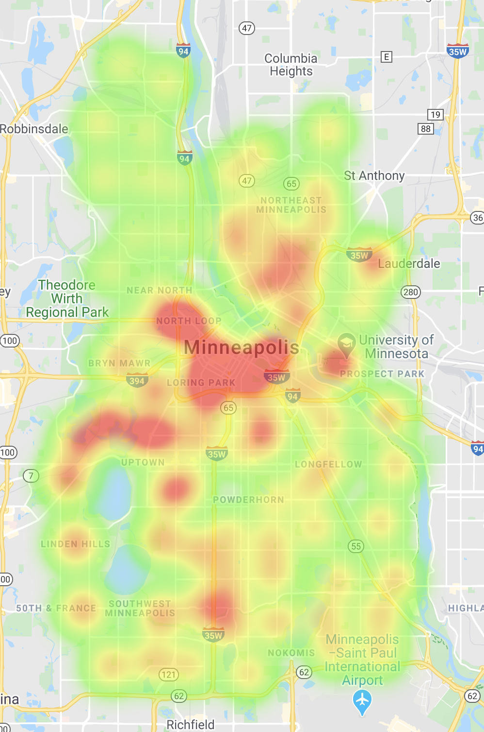
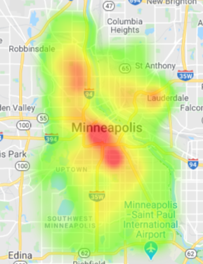
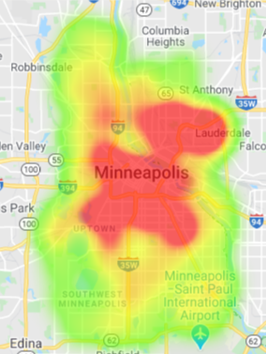
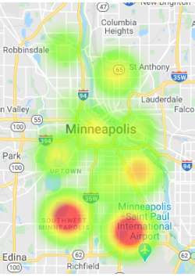
Data analysis
Home Value per Sqft
Violent Crime
Non-Violent Crime
School Rankings
Can we see a relationship here? Does:
Home Value = A + B*Violent + C*Non-Violent + D*School?
LET’S FIND OUT!

Slide 6
Data analysis Do home values differ between Minneapolis communities?
One-way ANOVA
Visually through boxplot and statistically via One-way ANOVA confirms that the mean home value per square foot does in fact differ between Minneapolis communities.
Reject the null hypothesis that mean home values do not differ by community.
We now attempt to identify what are the key factors driving the differences in home value per square foot?

Slide 7
Data analysis Are home values related to the home size?
Home value per square foot is not related to total home size. Therefore home size is rejected as an independent, explanatory variable for home value per square foot.
Put simply, it is not the fact that homes are bigger that is causing the difference in home value per square foot between Minneapolis communities.
We will now explore whether crime or school quality are drivers of the observed home value differences.

Slide 8
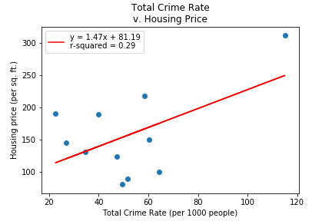
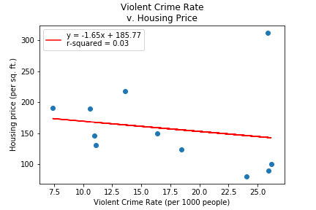
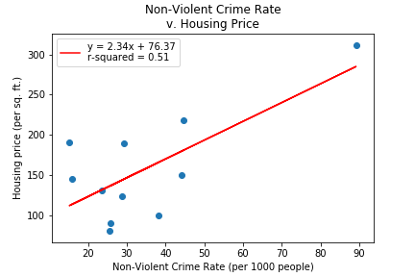
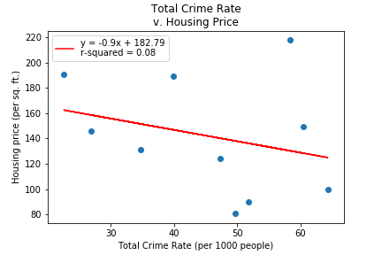
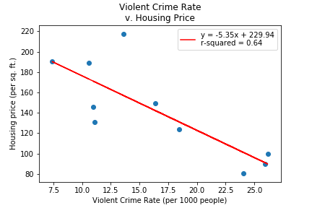
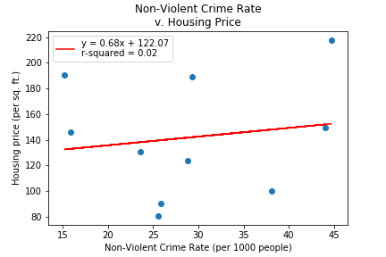
Data analysis Are home values related to crime in the community?
Including Central
Including Central
Including Central
Excluding Central
Excluding Central
Excluding Central
The rate of violent crime has a strong negative correlation with home value when the outlier community of Central is excluded.
The rate of non-violent crime has a positive correlation with home value when Central is included due to the high home values in central and the presence of non-violent crime in a busy downtown area.

Slide 9
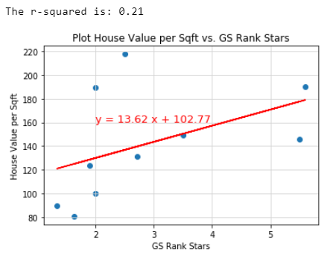
Data analysis Are home values related to community education quality?
There is weak correlation between school rankings and house value.

Slide 10
Data analysis Are crime and education in a community related?
There is weak correlation between school rankings and crime rate.
Therefore it is reasonable to consider both as candidates for independent variables for regression against home values.

Slide 11
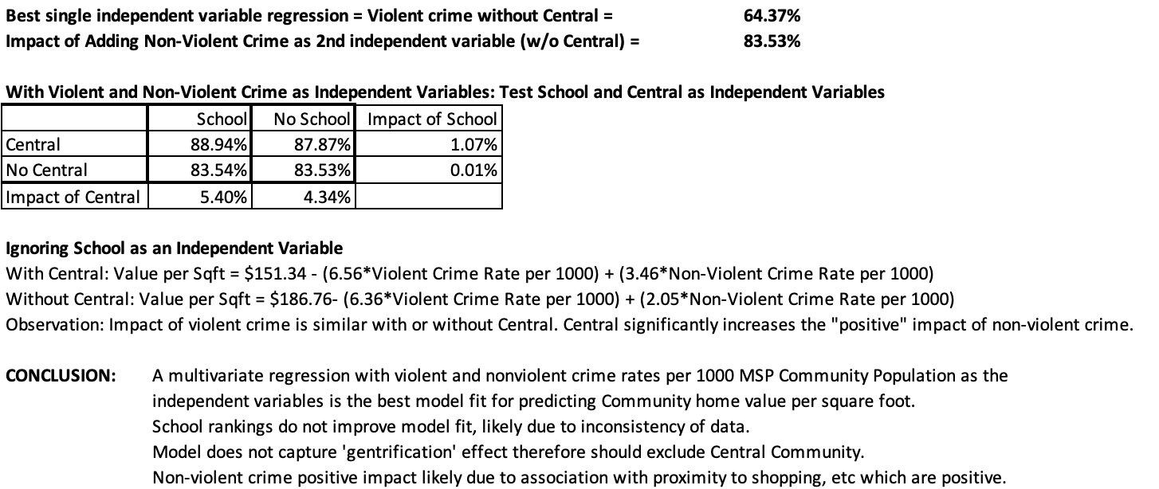
Data analysis Does crime and education explain home value variance between Minneapolis communities?

Slide 12
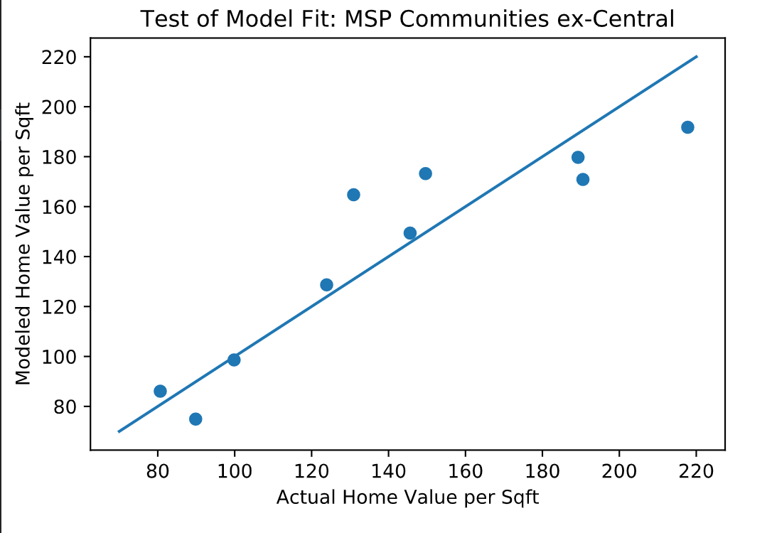
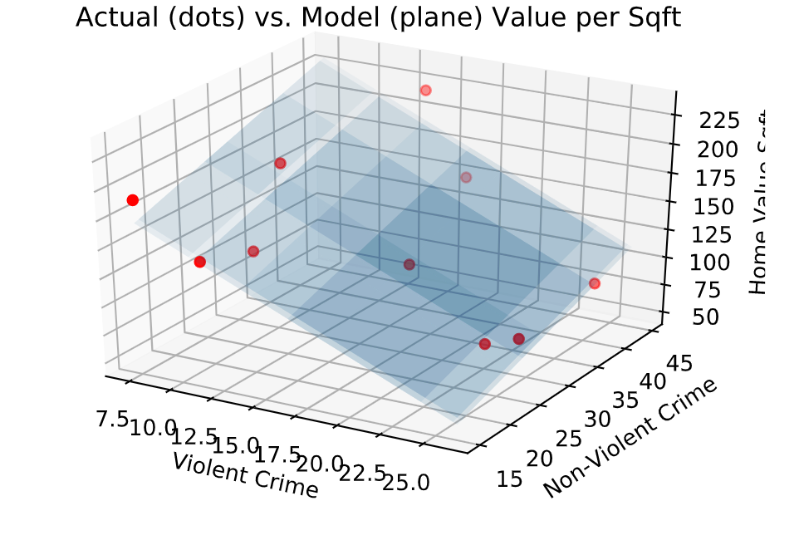
Data analysis Does crime and education explain home value variance between Minneapolis communities?
Final Home Value per Square Foot model with R2 = 0.8353
Home Value per Sqft = $186.76 – ($6.36*Violent Crime Rate) + ($2.05*Non-Violent Crime Rate)

Slide 13
Summary of conclusions
Minneapolis home values do indeed vary to a statistically significant degree between the 11 Minneapolis communities.
The size of the home is not a factor when home values are normalized to value per square foot.
Education rankings, at least as reported, do not impact home values significantly.
Likely due to poor and inconsistent metrics unsuitable to regression analysis.
A multivariate linear regression model demonstrates that:
64.37% of the variance in home values between communities can be explained by the rate of violent crime.
By adding non-violent crime as a 2nd independent variable this increases to 83.53%.
Home values on average decrease by $6.36 for each additional violent crime per 1000 residents.
Home values on average increase by $2.05 for each additional non-violent crime per 1000 residents.
This is likely due to the correlation between non-violent crime and nearby business and recreational activities which have a positive impact on home values.
Allocation of resources to address crime issues in Minneapolis communities will increase home values.

Slide 14
Discussion
Violent crime is a major driver of home values, as one would expect.
Non-violent crime is not strongly correlated with home values on its own.
However, in a multivariate regression inclusion of violent crime and non-violent crime as independent variables significantly improves R2 compared to violent crime alone.
This is likely due to the correlation between non-violent crime and areas of business or recreational activity.
School rankings had little to no additional model value.
The process of gentrification is difficult to capture, as in the case of Central Minneapolis. Would be very interesting to do same analysis significantly post-gentrification.

Slide 15
Questions?

Slide 16
Appendix

Slide 17
Data interrogation

Slide 18
Questions and data
What are the official Minneapolis communities and what are the home values in 2020?
Source of data: Open Minneapolis (http://opendata.minneapolismn.gov/)
Assessors Parcel Data 2020 – 130,719 records
What is the crime rate in Minneapolis communities?
Source of data: Open Minneapolis (http://opendata.minneapolismn.gov/)
Minneapolis Police Incidents from 2015 to 2020
What is the population of Minneapolis communities?
http://www.mncompass.org/ (gathering data from U.S. Census Bureau)
What is the quality of education in Minneapolis communities?
https://www.schooldigger.com/
https://www.greatschools.org/

Slide 19
Questions and data
Is the variance in home values between communities statistically significant?
Method - One-way ANOVA on mean home values by community.
Which communities’ home values differ significantly?
Method – Pairwise t-test on home values between community pairs.
With home value per square foot (val_sqft) as the dependent variable, what are the candidates for independent variables?
Is val_sqft related to house size?
Method – Linear regression val_sqft vs. house size.
Is val_sqft related to community violent or non-violent crime rate?
Method – Linear regression val_sqft vs. violent and non-violent crime rates.
Is val_sqft related to community education quality?
Method – Linear regression val_sqft vs. school ratings.
Are the chosen independent variables uncorrelated?
Method – Correlation and linear regression between independent variable pairs.
How much of home value variance is explained by crime and education respectively and together?
Method – Multivariate linear regression r-squared
How sensitive are home values to differences in crime rates and education quality respectively?
Method – Multivariate linear regression coefficients

Slide 20
Home data Crime data Education data

Slide 21
Data cleanup and exploration: Home data
JSON home value data was accessed from Open Minnesota using an API call.
Only 2000 records are allowed per call, necessitating a looped call.
The inclusion of neighborhood and community designation for each home made grouping and comparison relatively straightforward.
80+ neighborhoods and 11 communities. Communities chosen as basis of analysis to ensure adequate data in each group.
Data included commercial and residential real estate.
Data clean up included
Removing records with null values
Removing non-residential real estate records.
Removing extreme outliers with respect to home value and size as likely database errors.
Adding ‘Minneapolis, MN’ to the address field to facilitate use of Google Maps API accuracy.
Replace hashtag (#) in address field with %23 for Google Maps API call format.
Included below grade square footage in home size. This may lead to distortion depending on whether basements are generally finished or unfinished in different communities.

Slide 22
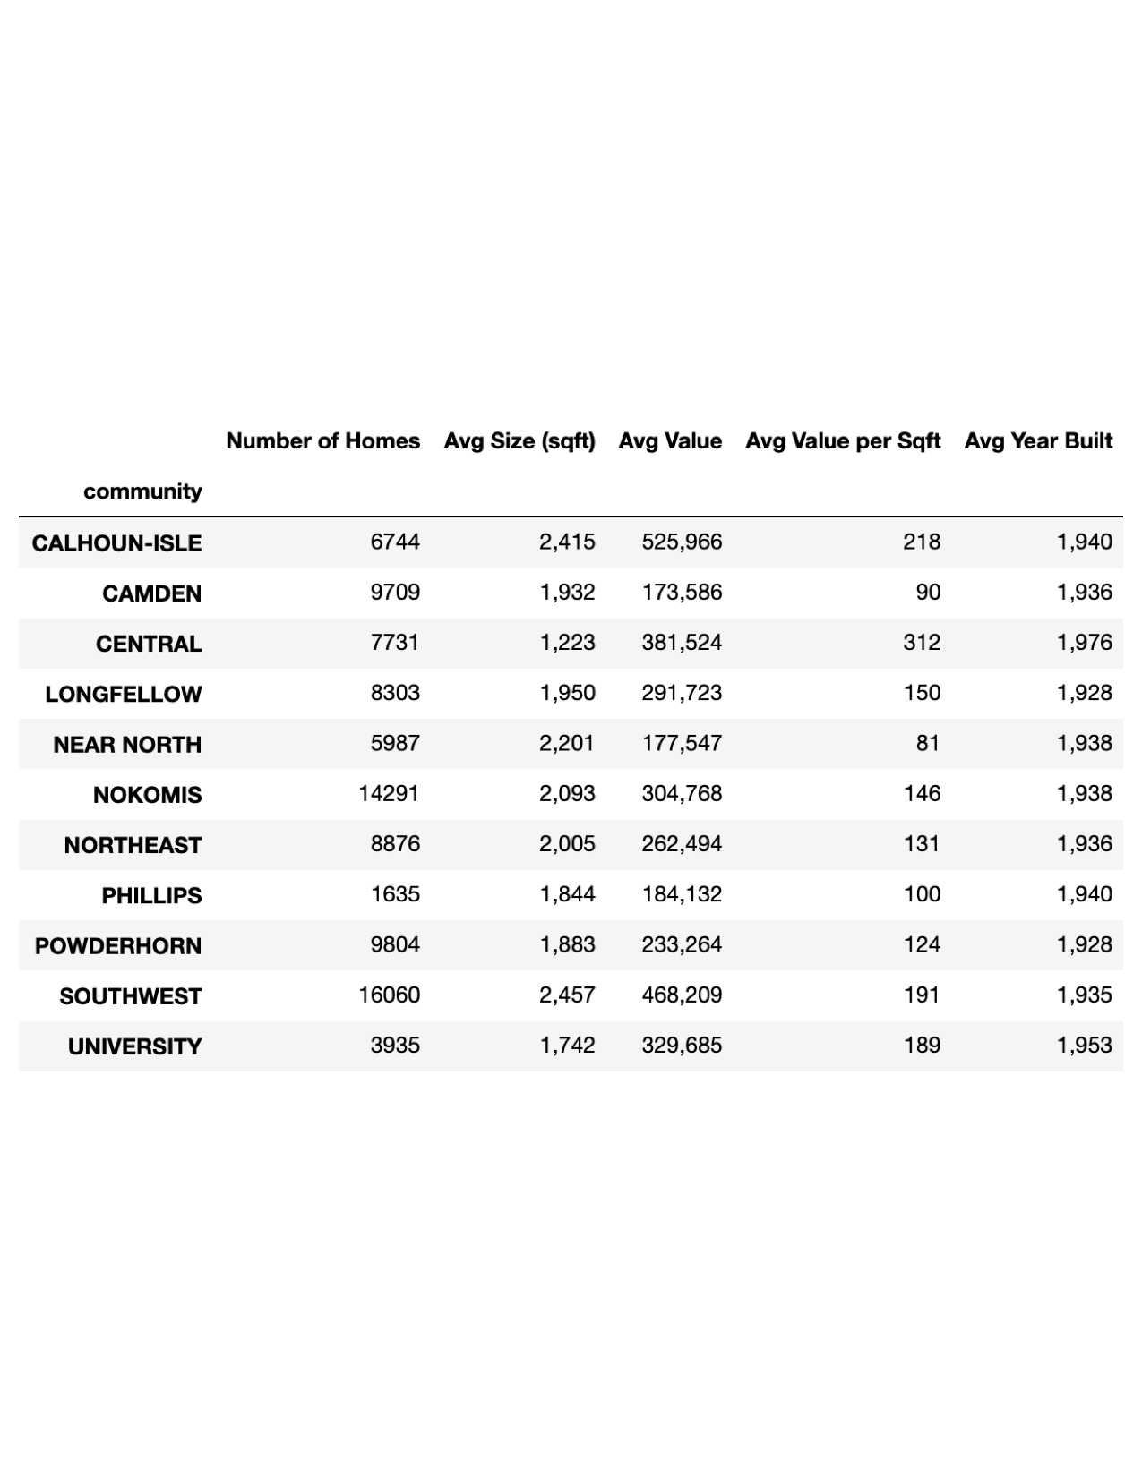
Data cleanup and exploration: Home data
Home Value per Sqft
Home data summary statistics by Minneapolis community
Based on the Minneapolis Assessor data there appear to be significant variations in home values between Minneapolis communities. We attempt to understand the key drivers of this difference

Slide 23
Data cleanup and exploration: Crime data
Crime data for Minneapolis was gathered from Open Minneapolis for 2015 through first quarter of 2020
Data cleanup included:
Merging spreadsheets for each year into one dataframe
Normalizing the name of each crime for consistency
Categorizing each crime as either violent or non-violent based on statutory definition of both violent crime and the crime itself
Crimes tallied per community to get crime rates for total crime, violent crime, and non-violent crime per 1000 people per year in each community

Slide 24
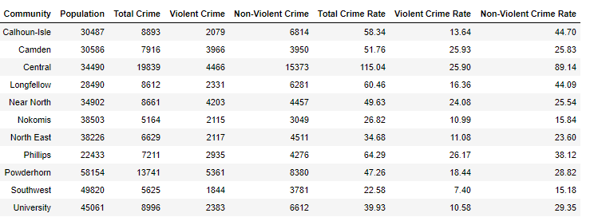
Data cleanup and exploration: Crime data
Heat maps of non-violent and violent crime rates show similar, but not identical, patterns of crime rates across the city. Downtown area has much higher crime rate than anywhere else in the city.

Slide 25
Data cleanup and exploration: Education data
JSON individual school background and ranking data was accessed from SchoolDiggeppr.com using multiple API calls corresponding to school categories.
There are 102 schools in the Minneapolis School District NCES District ID: 2721240.
Neighborhood and community designations were derived based on location.
Data clean up included
Replacing Nan with 0 values for some calculations
Manually creating GS Ranking Stars from GreatSchools.org to augment existing Ranking Stars which appeared to have multiple missing or misleading values.
Manual removal of outliers if needed.
Not able to find school ranking data for 42 schools. Hence, only 60 or less than 60% of schools had valid ranking data.
Such a small sample of possible school rankings made analysis of possible school quality positive correlations with home values challenging.

Slide 26
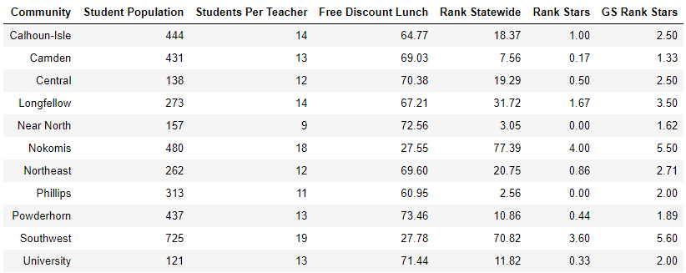
Data cleanup and exploration: Education data
Data cleanup and exploration: Education data
GS Rank Stars Education data summary statistics by Minneapolis community
Based on the combined educational data from SchoolDigger and GreatSchools there appear to be significant variations in school ranking measures between Minneapolis communities. We investigated the key drivers of this difference, including the effects of student population and students per teacher metrics.
[AB]

Slide 27
Post-mortem/lessons learned
Getting an API from a commercial enterprise can take a long time.
Identifying a common data field/key between different data sources can be challenging. E.g. neighborhoods vs. communities vs. police precincts vs. school districts.
Outliers can significantly distort conclusions if not identified.
Subjective data like school ratings can be inconsistent.

Slide 28
End of document

